Slide 1


Slide 2
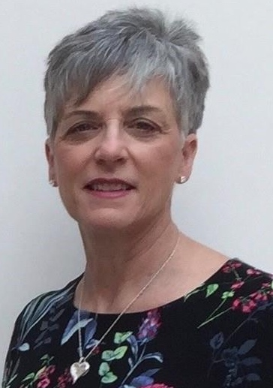
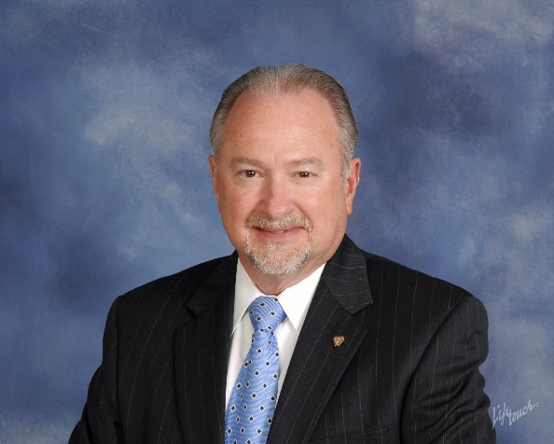
THE ROTARY FOUNDATION
Your Legacy – Rotary’s Promise
Part V TRF Learning Series
Richard B. Glover, PDG (2018-2019)
D-7620 of Central Maryland and District of Columbia
District Rotary Foundation Chair
v.012521
Laurie Menzel
Rotary International – Major Gifts Officer
Northern Virginia, West Virginia, Maryland, Washington DC, Delaware, and part of Tennessee
Notes:
( RICH )
Please welcome a fellow Rotarian and our Zone 33/34 RI Major Gifts Officer. Welcome Laurie. OUR time this evening is make-up for those who may have missed our presentation on Your Legacy – Rotary’s Promise.
Next …

Slide 3

Introduction
Your Legacy – Rotary’s Promise
District 7620 will celebrate a twelve month fundraising campaign for The Rotary Foundation Legacy Funds.
The evening brings together donors who have made or pledged new contributions or bequests of US $10,000 or more to The Rotary Foundation during the Legacy Fund campaign period ending October 2021.
“It seems eminently proper that we should accept endowments for the purpose of doing good in the world, in charitable, educational or other avenues of community progress …”
— Arch Klumph, 1917, Founder

Slide 4
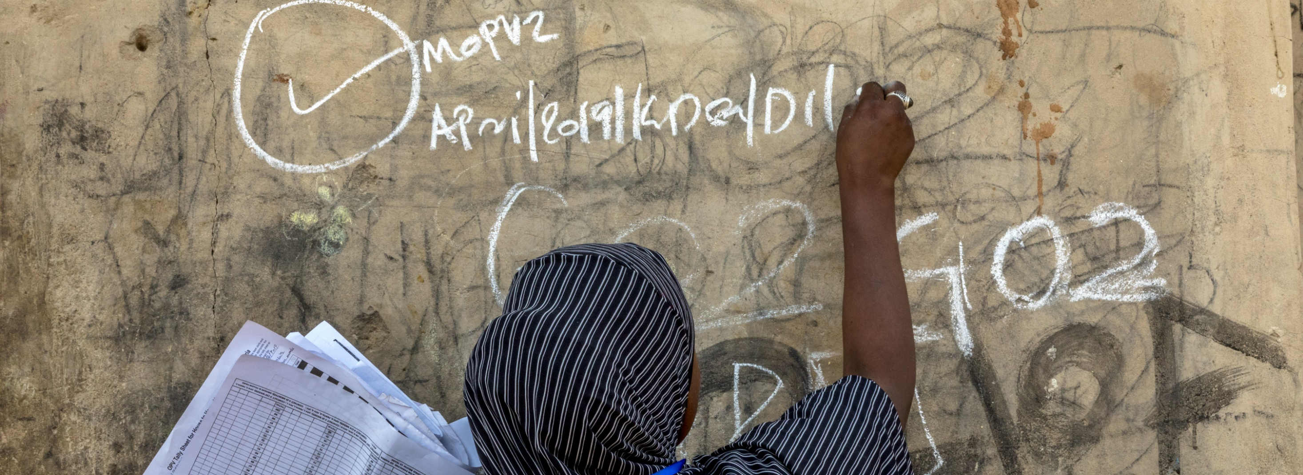
District 7620
Member Donors and Club Recognition Dinner 2021
Featuring special Recognition for our Legacy Fund Donors
Sunday, November 21, 2021, 6:00pm – 9:00pm
TuRf Valley Resort & Conference Center
2700 Turf Valley Rd, Ellicott City, MD 21042
Notes:
( RICH ) We are announcing a 12 month Campaign to continue the awareness of the value of the TRF.
In November 2021, we will have a spectacular event to recognize and present appreciation to our donors to the TRF.
The legacy funds campaign will be significant on this evening, as we have not had a campaign of this sort in recent memory.

Slide 5
Questions and answers you need to know
Our district leadership’s understanding and support
Will make the difference of success
Those in need are the customer – Leadership is the driver - The club members deliver results
Learn the facts first-hand from the Event Chairman on what this Legacy event represents.
Why is it so important for club officers to be familiar with the Legacy event facts?
Is the district putting out the hand “looking for a check” for this event? (No)
How does the COVID-19 pandemic impact member consideration to participate?
Is participating in this legacy campaign required?
What is the time-line window to promote this event?
Who is eligible?
What does a “Pledge” mean?
What is the level of confidentiality?
How do we successfully promote this Legacy event?
What is the meaning and impact of this Legacy campaign?
Is there a goal?
What are helpful “talking points”?
Will we have a review of the Legacy Fund opportunities?
Notes:
( RICH ) Leadership will need to be the Driver. If we understand the mission and inspire the clubs and members with specific information with measurable outcomes, they will deliver with spirit and participation in the art of giving.

Slide 6
Why is the TRF such a big deal
We are the best stewards of your Money
TRF is an award winning Global organization
by how we steward our money
As a global organization, we are efficient with over 92% of the funds raised going to programs. This efficiency contributes to significant recognition from independent evaluators. TRF has received yet another four-star rating from Charity Navigator, America’s largest independent charity evaluator. This is the thirteenth consecutive year that TRF has received a four-star rating.
Only 1% of the charities they evaluate have received at least ten consecutive four-star evaluations.
Charity Navigator rates over 9000 charities and only about 60 receive 4 stars.
How many charities are in the US? Over a million. TRF is also #1 of the listed charities on GuideStar website as one of the ten best charities that everyone’s heard of.
Last year we also received: An A+ rating from the American Institute of Philanthropy; We are named “World’s Outstanding Foundation” by the Association of Fundraising Professionals
Notes:
Why is TRF such a big deal? We are an award winning global organization graded because how well we are stewards of your money. 91% of TRF funds go to programs, Charity Navigator rates over 9000 charities and only about 60 receive a four star rating. TRF has received the 4 star rating for 12 years in a row. Only 1% of charities evaluated by Charity Navigator have received10 consecutive years with a 4-star rating. There are over a million U.S. charities and TRF is #1on Guidstars website as one of the ten best charities that everyone has heard of. This is why we are promoting TRF Legacy Fund opportunities.

Slide 7
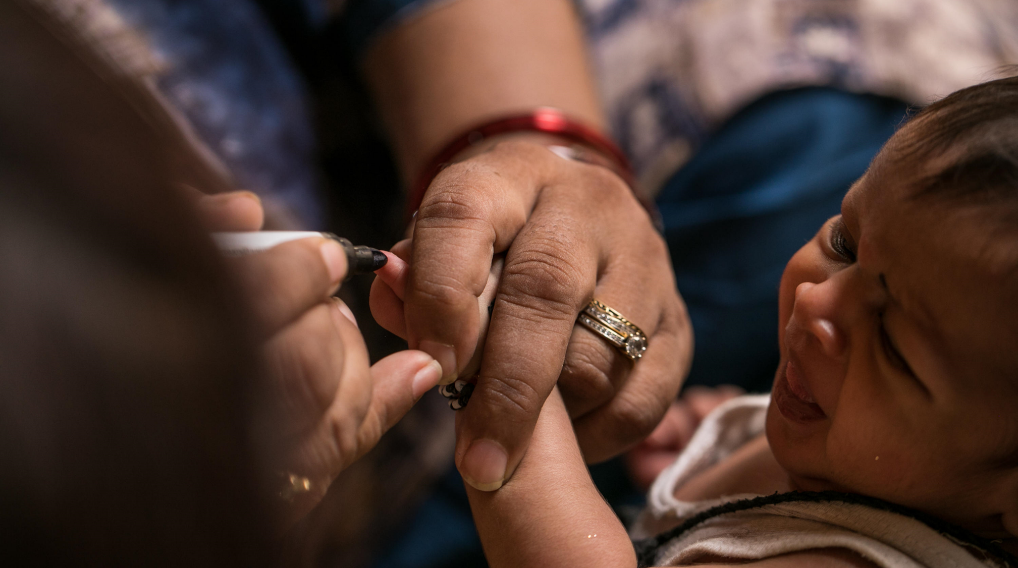
subhead
Time Line for Launch
“May our happiness increase with our usefulness. What Rotary will be one hundred years hence, none living can imagine.” – Paul Harris, Founder
DRFC Team
Ambassador Team
TRF Ambassador one-on-ones
Introduction Trainings x 3
Event Flyer
Zoom – Ambassadors, DELT, AG, P, PE, Club TRF, COG, Exec. Secretary, Treasurer, Grants Committee
  Present to Club BOD
  Club Notification
  Club Presentation
  Fireside Presentation
  Individual Presentation
Notes:
Even tough this presentation is #3 of 3, Laurie & I still welcome any additional requests for individual, group firesides and club program presentations on an as needed basis throughout the campaign.

Slide 8
subhead
FACT SHEET - WAYS TO GIVE
Interested in supporting TRF & D-7620 Legacy Funds Recognition Dinner? We ask you to consider a gift of $10,000 or more to The Rotary Foundation. Your Legacy – Rotary’s Promise
Support the cause You care about Today
Leave Your Legacy for Future Impact
  Pledge- Gift of $10,000+ Three years with equal payments
  Gift of Appreciated Stock
  IRA (Qualified Charitable Distribution)
  Donor Advised Fund
  Naming Rotary in your will or living trust
  Designate Rotary as a Beneficiary of your Retirement Plan
  Designate Rotary as a Beneficiary of your Whole Life Insurance Policy
Notes:
( Rich)
Let’s review the Fact Sheet:
Support the cause YOU care about -
Specific ways to leave your legacy for future impact.
Now, let’s have a quick further review of examples of Legacy Fund opportunities – Laurie, would you walk us through the following opportunities…

Slide 9

Annual gifts to The Rotary Foundation help people in our communities and around the globe live better lives today.
9
Notes:
( RICH ) - Just as your gifts to Rotary’s Annual Fund are helping people today… NEXT …

Slide 10

LEAVING A LEGACY
Planning a gift to Rotary’s Endowment supports these same life-changing programs forever.
Notes:
( RICH ) …planning a gift to Rotary’s Endowment will help people by supporting your favorite causes forever. NEXT ….

Slide 11

Beneficiary Designations:
Retirement Accounts
Life Insurance
Notes:
( LAURIE) - The gift options mentioned in this section are available almost exclusively in the United States.
If you are 70½ or older, you can make gifts to Rotary directly from your Individual Retirement Account to satisfy your requirement minimum distribution and qualify for a tax deduction.
See your gift in action
Do good with your Required Minimum Distribution from your IRA
Reduce income tax with a deduction or the Qualified Charitable Distribution (IRA Rollover)
Prevent double taxation on inheritances
Receive Major Donor recognition and Arch Klumph Society membership

Slide 12

Will or Living Trust
Notes:
( LAURIE )
Will- specific amount or percentage
The Rotary Foundation of Rotary International
Creating the personalized legacy- do that with a TGA

Slide 13

Charitable Gift Annuity and Charitable Remainder Trust
Notes:
( LAURIE ) - The gift options mentioned in this section are available almost exclusively in the United States.
Charitable Gift Annuities and Charitable Remainder Trusts are a great way for individuals and couples who are at least 50 years old to save money on unnecessary taxes and turn low-yielding assets into a regular income stream.
Charitable Gift Annuity. Fixed payments for life - backed by the unrestricted assets of The Rotary Foundation.
Charitable Remainder Unitrust. Variable payments for life backed by the assets in the trust.
Partial charitable income tax deduction
Minimize capital gains tax
Face value counts towards Major Donor or Arch Klumph Society membership
Continues doing good in the world in Rotary’s Endowment
For charitably minded, rates may be higher than certificates of deposit

Slide 14

Donor Advised Fund
Notes:
( LAURIE ) - The gift options mentioned in this section are available almost exclusively in the United States. Please delete these slides before sharing this presentation in another region.
Rotary’s Donor Advised Fund makes it easy for your family to support their favorite charities through a single tax-efficient account. You can set aside funds for later charitable use, maximize deductions in years they are most valuable, and avoid unnecessary capital gains taxes on gifts of appreciated stock.

Slide 15
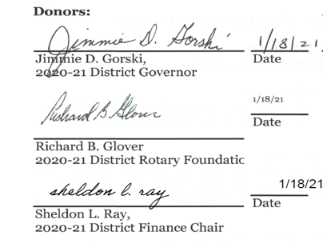
District’s strong financial position leads to creation of an endowment fund to benefit district clubs
On January 22, 2021, The Rotary Foundation Chief Philanthropy Officer approved the establishment of the
“District 7620 Central MD & DC Endowment Fund”

Slide 16
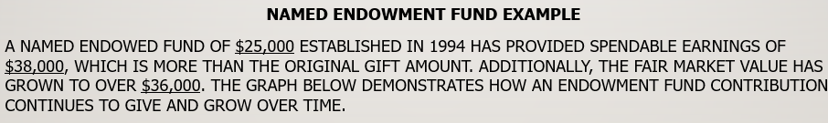
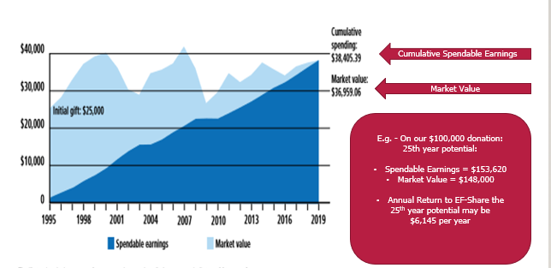

Slide 17
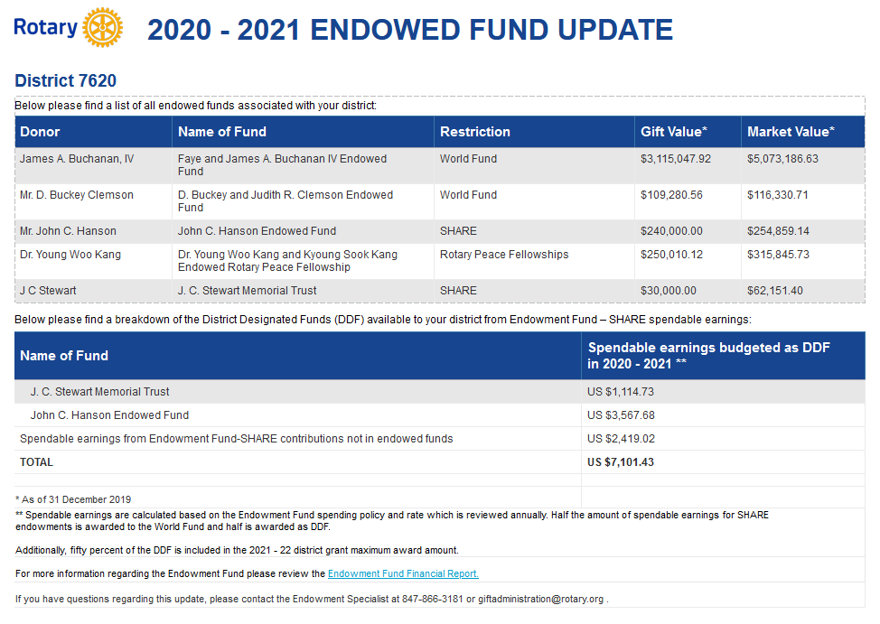
Directed to EF-Share
Directed to EF-Share
EF-Share Received 2020-2021

Slide 18
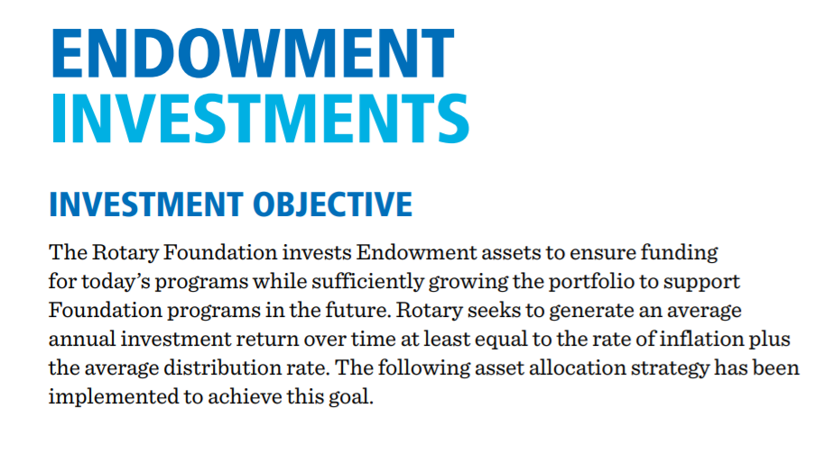
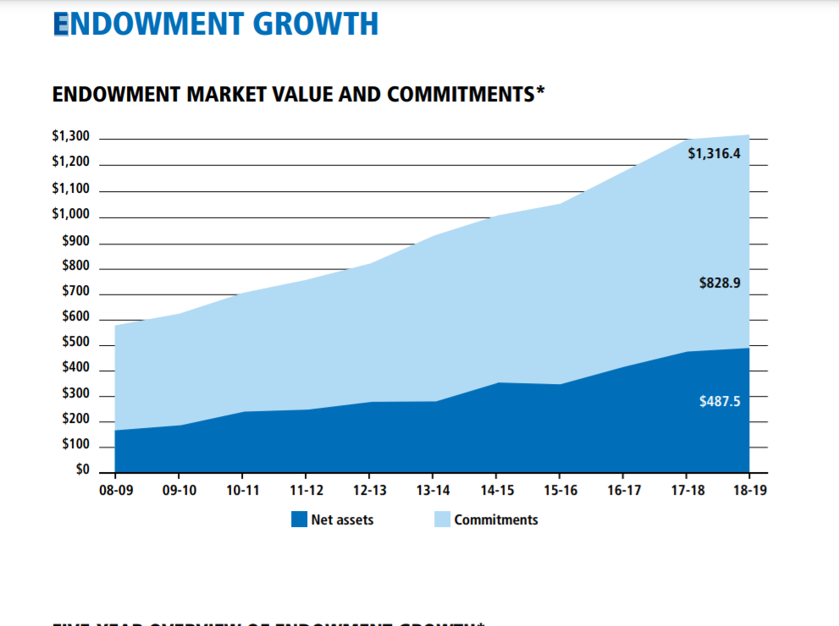
Strategy Results
Now is 1.432 Billion

Slide 19
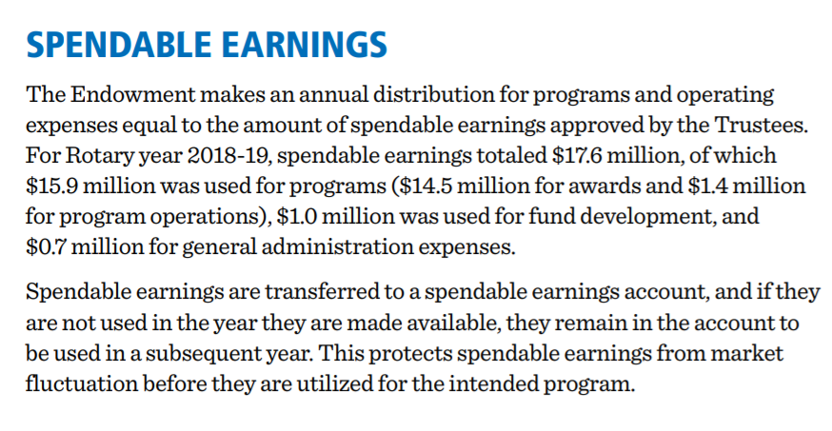
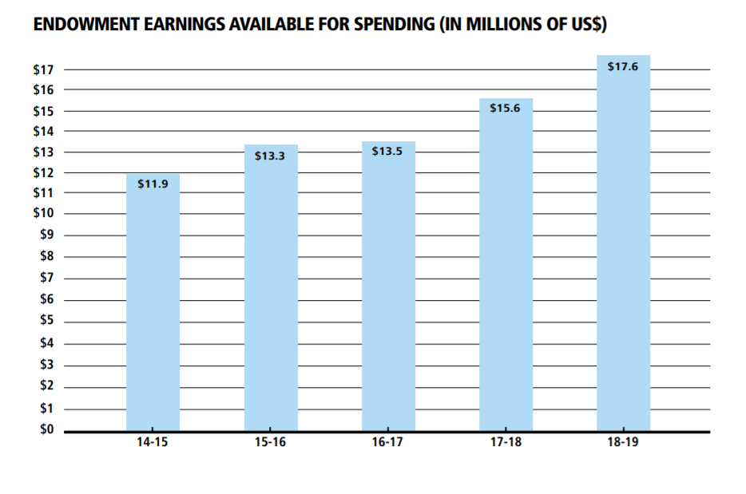
Endowment INVESTMENT EARNINGS

Slide 20
7620 Central MD & DC endowment Fund
Club member participation in district
Anyone may contribute to the “District 7620 Central MD & DC Endowed Fund.”
Contributions may be made by check, or donations of IRA’s and Stocks .
Contributions by check must identify “District 7620 Central MD & DC Endowed Fund - E12224” as the recipient in the memo section, and must enclose the “TRF Contribution Form #123.” Send to The Rotary Foundation, 14280 Collections Center Drive, Chicago, IL 60693.
To wire funds, please consult the DRFC for wire instructions.
Gifts to the endowment earn giving credits toward the Major Donor recognition.
Gifts to the Endowment do not earn Paul Harris Fellow points or count toward Paul Harris Society.

Slide 22
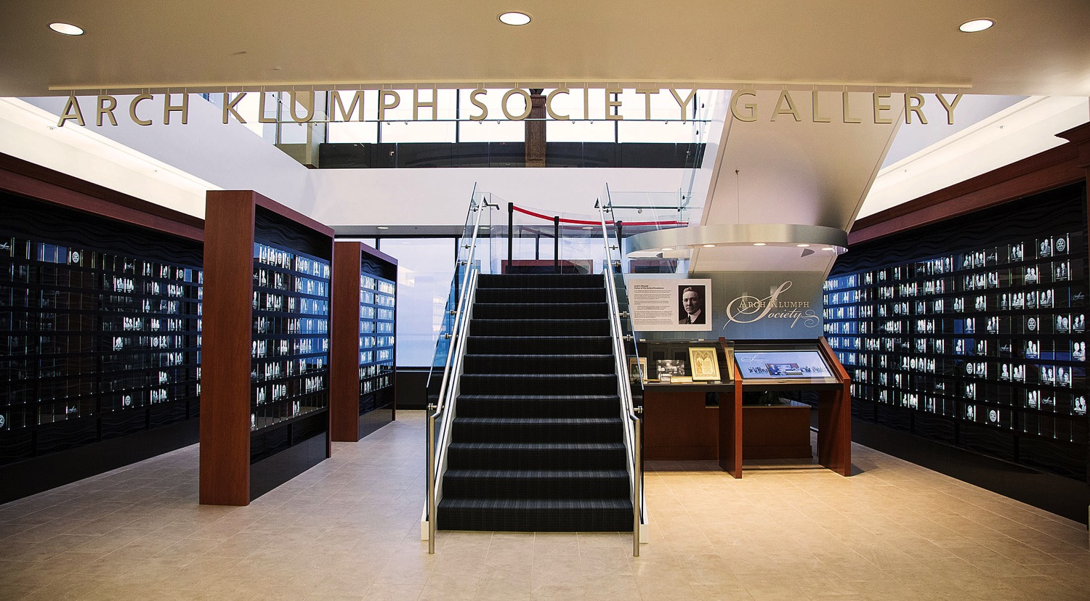
Arch Klumph Society
Notes:
* As gifts to the Foundation became increasingly generous, the Trustees saw the need for special recognition for very large donations. In 2004, they established the Arch Klumph Society to recognize individuals, couples, and organizations whose cumulative contributions total $250,000 or more.
* Arch Klumph Society members are given the opportunity to attend an induction ceremony and have their portraits displayed in the Arch Klumph Society gallery at Rotary International World Headquarters in Evanston (shown here). And since 2005, the Foundation has also honored these members at a dinner during Rotary’s annual convention.

Slide 23
Gift Cultivation Ideas
Current Donor Level:
New Donor Recognition:
  A Paul Harris Society Member
  A Major Donor $10K – $15K from next Major Donor Level
  A Major Donor or Arch Klumph Society Member
Bequest Society Member
Next Level of Major Donor Or Arch Klumph Society
Bequest Society Member
Notes:
So, how do you know who may be a candidate? As we have stated, TRF RI is very clear on it’s policy of Confidentiality. Laurie has produced a sorted current giving data sheet by club, minus Anonymous donors.

Slide 24
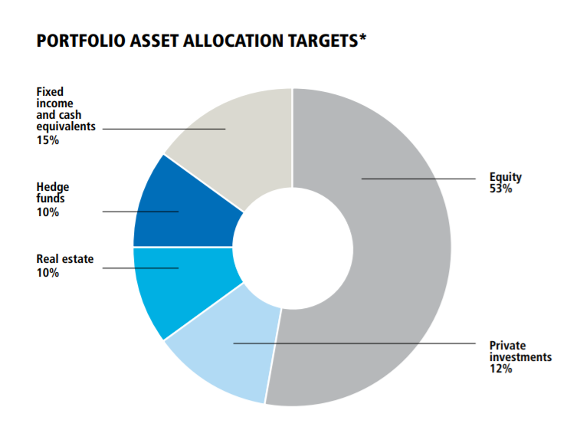
Endowment Investments
&
Allocation Targets

Slide 25
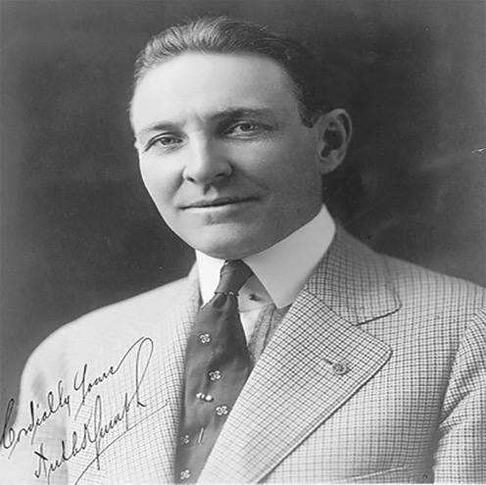
Rotary’s tomorrow depends on what we do today.
“
“
– Arch C. Klumph
Notes:
As Arch Klumph put it best when he said, “Rotary’s tomorrow depends on what we do today.” More than 100 years ago, Rotarians took bold action to ensure your success and the empowerment of generations still to come — they established The Rotary Foundation to secure a better future.
Like the grandfather planning an apple tree, Rotary’s Endowment makes it possible to continue your Rotary work well into the future.

Slide 26
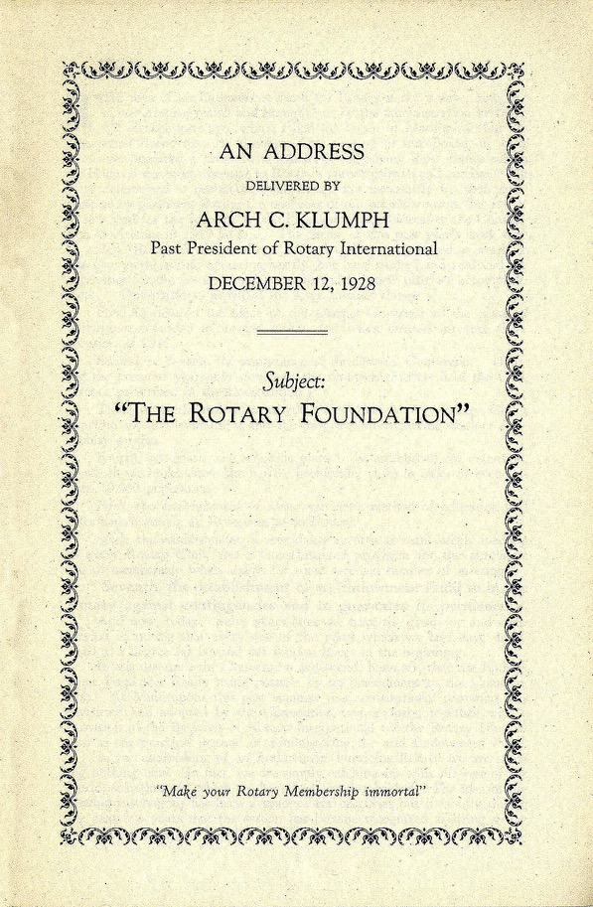
The Rotary Foundation and Trustees — 1928
We are determined that the Endowment Fund shall not be unpopular. … We truly believe that when each and every individual Rotarian understands this matter thoroughly and correctly, there will be few, if any, who do not participate, even though the sum may be extremely modest in amount.
— Arch Klumph, 1928
Notes:
* Have attendee read Klumph’s quote.
* In 1927, Rotary leaders began to show greater interest in the endowment, and the following year, convention delegates formally changed its name to The Rotary Foundation. They also agreed to enlarge its scope and establish a five-member Board of Trustees.
* The Rotary president appointed the first trustees and named Arch Klumph the trustee chair. He served as chair for seven years, educating Rotarians about the Foundation and encouraging them to contribute.
* Although Arch believed strongly in the need for the Foundation, he emphasized that all contributions should be voluntary. He did not want Rotarians to view the Foundation as a tax or assessment on clubs or members, which would have violated the association’s constitution.
* Today, the Foundation has 15 trustees who manage the Foundation’s business. They are nominated by the RI president-elect and elected by the RI Board to serve four-year terms. The trustees elect a chair each year. Click on https roster of trustees.

Slide 27
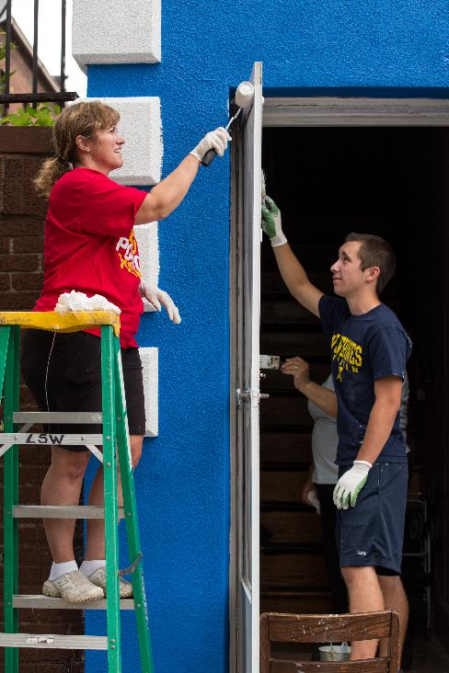
Point of Contacts
For More information contact:
PDG/DRFC Rich Glover
18.19.dg7620@GLOVERCREW.NET
301.980.4976
Laurie Menzel, Major Gifts Officer
The Rotary Foundation
Laurie.Menzel@Rotary.org
847.425.5601

Slide 28


QUESTIONS
PDG Rich Glover, District Rotary Foundation Chair
Cell: (301) 980-4976
Email: 18.19.dg7620@glovercrew.net
Notes:
We have ___________ minutes remaining in the hour and I would enjoy any clarifications and questions may have.

Slide 29
Be Aware – Be Informed – be inspired
repeated Zoom presentations for district leadership
to fit your busy schedules
Call Rich or Laurie for group or individual session requests
District Executive Leadership Team (DG, DGE, DGN, DGN-D, Treasurer, DRFC)
Event Ambassadors
Council of Governors
District Executive Secretary
District Area Governors
District Committee Chairs
Club President & Club President Elect
Club Rotary Foundation Chair & Chair-Elect
Grants Committee Members
Club Presentations
Fireside Chats
Individuals
Notes:
( RICH )
Because of the unique nature of giving through Legacy Funds, it important that we start at the top of the leadership chain to MAKE SURE we are aware of the event, Be informed of the facts and Hopefully be inspired of this enormous impact throughur legacy giving.

Slide 30

What can your legacy support?
SHARE
World Fund
7 Area of Focus
Rotary Peace Centers
Notes:
( LAURIE )
Remember, you are the one who determines which Areas of Focus is most important to you.

Slide 31
Worldwide Events
WW Members with Annual Fund Giving
Depression
WWII
Hong Kong flu 1M perished
Energy crisis & recession
Black Monday & recession
Asian financial crisis & dotcom bubble
2008 recession & EU debt crisis
Membership
Giving (USD)
Notes:
The Foundation’s assets grew slowly over its first 30 years. At the end of the 1947-48 Rotary year, it had received only about $2 million in contributions since 1917.
* Today, the Foundation’s Endowment assets stand at more than $1.2 Billion. What led to such a remarkable increase in donations?
Worldwide events had had impact on Membership and Giving.
Membership and Giving amounts over the years shown alongside economic & health events
( Laurie ) I believe you have a comment as well on the status of TRF giving in the midst of Covid.

