Slide 1

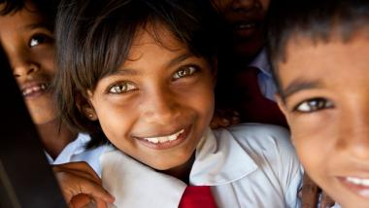
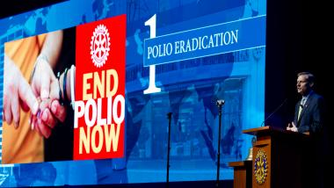

Slide 2
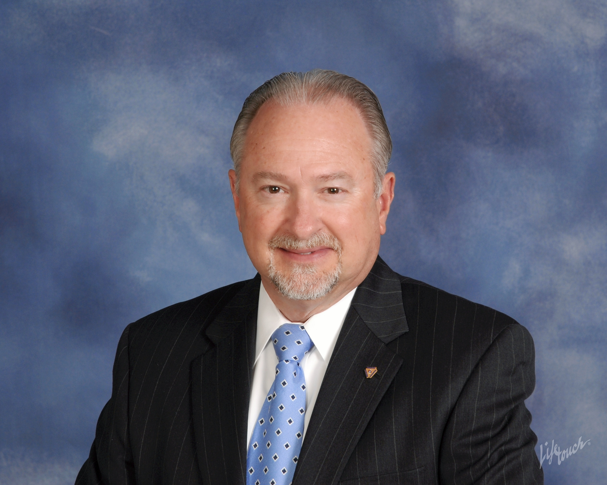
The Rotary Foundation
District 7620
Education Series for 2021-2022
PDG Rich Glover 2018-2019
District 7620 Rotary Foundation Chair 2019-2023
Part VI
PolioPlus
Our founding Father’s
Why are we still immunizing Kids
what is the plus?
We are that Close to eradicating Polio in the world
v. 03/18/21

Slide 3
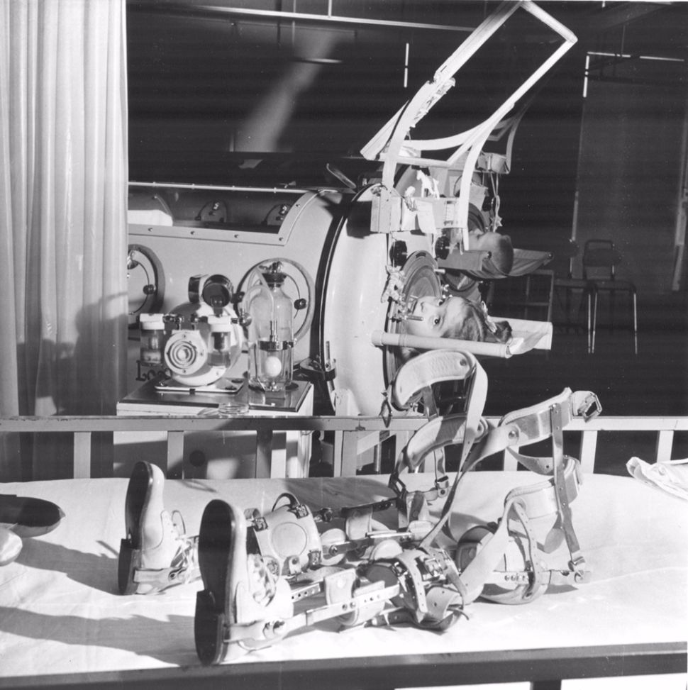

“We are that Close”
The Iron Lung
National Immunization Day

Slide 4
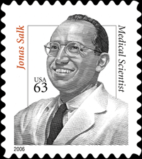
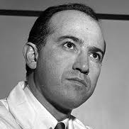
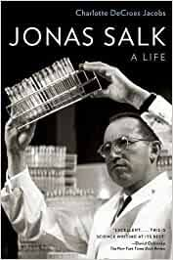
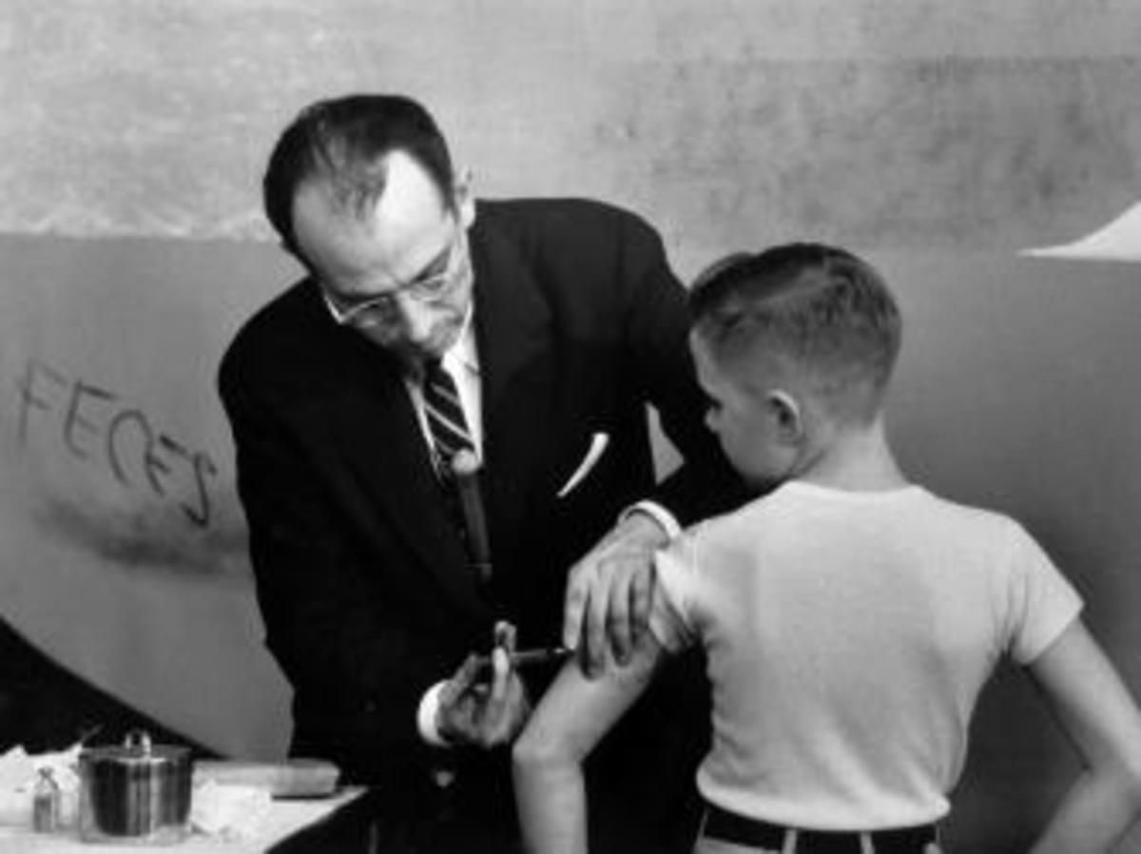
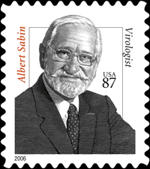
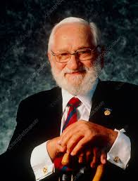
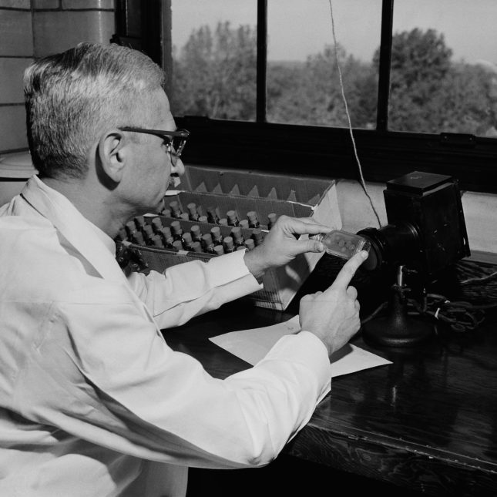
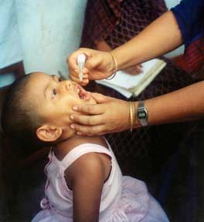
The Vaccine
That Changed The World
Dr. Jonas Salk (1914–1995) became a national hero when he allayed the fear of the dreaded disease with his polio vaccine, approved in 1955. Although it was the first polio vaccine, it was not to be the last;
Dr. Albert Bruce Sabin (1906–1993) introduced an oral vaccine in the United States in the 1960s that replaced Salk's.

Slide 5
The Vaccine
Which Vaccine are we using & why
IPV (injection) is more expensive and more difficult to administer than OPV.
OPV (oral), on the other hand, provides better mucosal immunity than IPV.
But because OPV is a live virus, it can replicate and revert to a neurovirulent form that endangers its host and could fuel outbreaks.
Until polio is eradicated globally, OPV is still the main preventative measure against polio. IPV is recommended in addition to OPV and does not replace OPV. IPV is a very safe vaccine in humans, whether used alone or in combination vaccines.

Slide 6
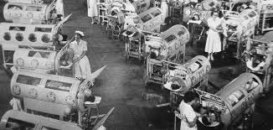
Without the Vaccine
Hospital respiratory ward in Los Angeles, 1952

Slide 7
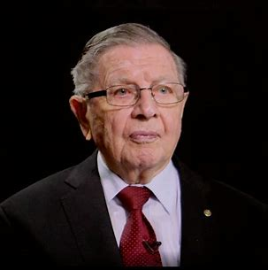
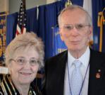
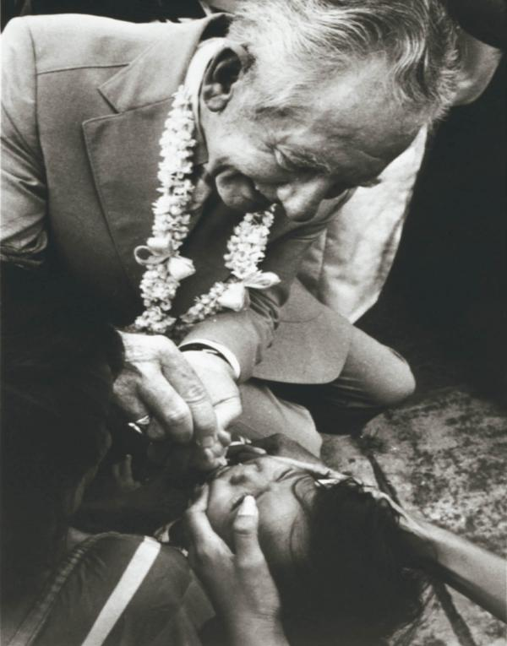
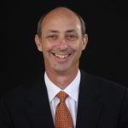
How Did the Idea of Polio Eradication
Become a Global RI/TRF Initiative
“Founding Fathers:” We are fortunate that two of the Rotary leaders who were instrumental in leading Rotary towards polio eradication in the late 1970’s. Sir Clem Renouf, RI President 1978-79, and Dr. John Sever, Chief of the Infectious Disease Branch, Institute of Neurological Disease, NIH and District Governor of Rotary District 7620 1978-79.
RI President Clem Renouf – 1978-1979
RIP Asked the question?
District 7620 Member RC of Potomac
PDG Dr. John Sever – 1978-1979
Offered a solution
RI President James L. Bomar Jr. - 1979-1980 - USA
Put the first drops of vaccine into a child’s mouth
District 7620 Member RC of Columbia – Patuxent
PDG Ken Solow - 2015-2016
Producer – Dare to Dream Documentary
Notes:
“Founding Fathers:” There are two of the Rotary leaders who were instrumental in leading Rotary towards polio eradication in the late 1970’s. Sir Clem Renouf, RI President 1978-79 - Australia, and Dr. John Sever, Chief of the Infectious Disease Branch, Institute of Neurological Disease, NIH and District Governor of Rotary District 7620 1978-79.
Rotary International’s effort to eradicate polio began in 1979, with a multiyear 3-H grant to immunize 6 million children in the Philippines.
In 1918, PDG Ken Solow 2015-2016 Produced the Polio Documentary “Dare to Dream”. View this film https://daretodreamfilm.com/

Slide 8
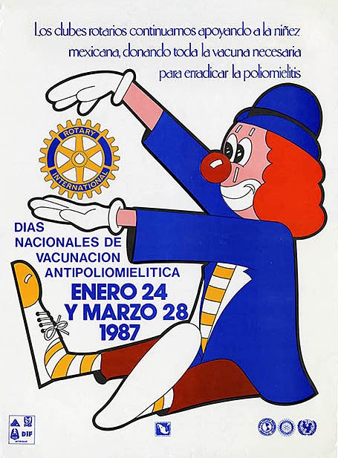
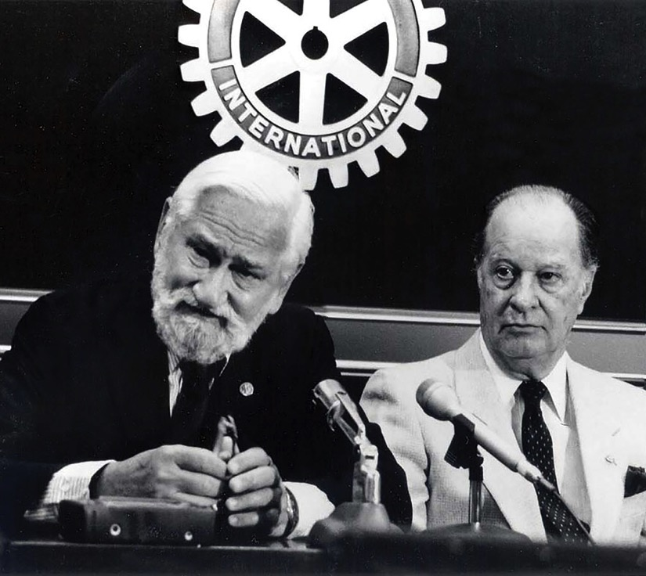
National Immunization Days
Notes:
* The polio eradication initiative owes much of its success to its adoption of mass immunizations, which were advocated by Dr. Albert Sabin (shown at left in the photo), who developed the oral polio vaccine, and Rotary leaders and physicians Carlos Canseco (shown at right in the photo) and D-7620 PDG Dr. John Sever – 1978-1979.
* For a typical National Immunization Day, or NID, thousands of immunization posts are set up throughout a country. Health workers and volunteers immunize millions of children in one day. In what’s known as social mobilization, both during the NID and before, volunteers hang posters, distribute handbills, and even ride through the streets with bullhorns to urge parents to bring all children younger than five to be vaccinated.
Those who receive the oral polio vaccine have their fingers marked with indelible ink. Over the following few days, health workers go from home to home, administering vaccine to eligible children with unmarked fingers. The process is repeated once a few months later, and then again, with the goal of reaching every child under age five every time.

Slide 9
The Roots of Rotary’s polio eradication efforts
Rotary International’s effort to eradicate polio began in 1979, with a multiyear 3-H grant to immunize 6 million children in the Philippines.
On 29 September 1979, volunteers administered drops of oral polio vaccine to children at a health center in Guadalupe Viejo, Makati, Philippines.
When James L. Bomar Jr., then RI president, put the first drops of vaccine into a child’s mouth, he ceremonially launched the Philippine poliomyelitis immunization effort.

Slide 10
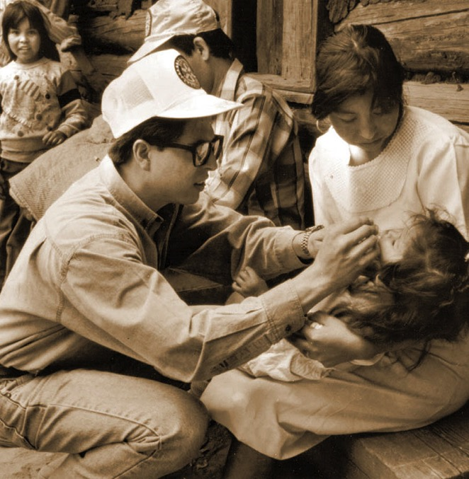
PolioPlus — 1985
1980
Rotary’s Council on Legislation endorses a proposal to “eliminate polio through immunization”
Immunization efforts continue as part of the 3-H program
1985
PolioPlus is launched
Notes:
The project in the Philippines was just the beginning.
The 1980 Council on Legislation endorsed a proposal from the RI Board to “eliminate polio through immunization.” This allowed Rotary to promote immunization without violating a 1923 decision that prohibited “corporate projects.”
In 1984, the RI Board made a series of decisions that resulted in what we now know as the PolioPlus program and established a fund to support it. Initially, the program was called Polio 2005, in reference to a goal of immunizing all the world’s children by 2005.
Rotary leaders announced these ambitious plans in early 1985, and later that year, they introduced the program’s new name: PolioPlus. The “Plus” initially referred to the additional vaccines that were administered along with polio vaccine.
Today, it also reflects the idea that the infrastructure, fundraising, and advocacy methods implemented by the polio eradication effort will support future battles against infectious disease.

Slide 11
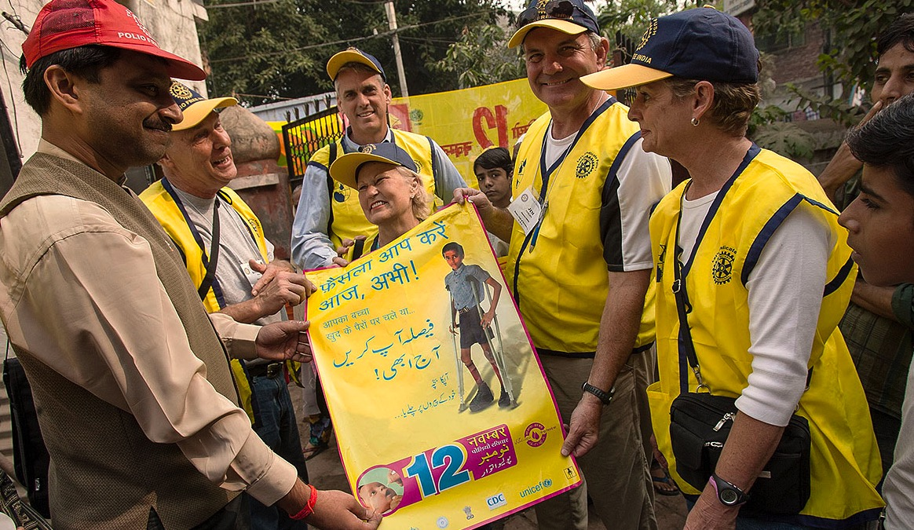
POLIOPLUS PARTNERS – 1995
Notes:
* The social mobilization that precedes an NID is critical to the success of mass immunizations. In 1995, the Foundation launched the PolioPlus Partners program to support social mobilization for National Immunization Days.
* Through PolioPlus Partners, a network of regional and national PolioPlus committees determine what supplies are needed, such as vaccine carriers, banners, brochures, and PolioPlus T-shirts, aprons, and caps to identify members of vaccination teams. The national committee chairs distribute the list, and the program provides funding.
* When India prepared for its first National Immunization Days in 1995, it identified a need for hundreds of aprons for volunteers. Japanese Rotarians contributed enough funds to buy not only aprons but also caps, posters, banners, and vaccine carriers. Indian Rotarians mobilized about 100,000 volunteers to publicize the upcoming immunizations and administer the vaccine.

Slide 12

The Questions!
Which vaccine are we using and why?
Why are we vaccinating in so many countries?
What caused the increase in wild polio cases in 2019?
How is Covid-19 affecting the fight against polio?

Slide 13
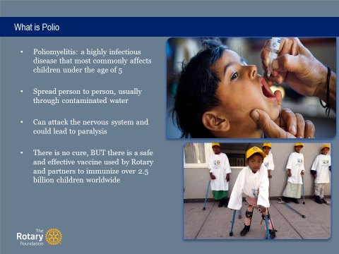
Polio Refresher
Highly infectious virus (3 types)
affecting children under 5
Spread person-to-person by poor sanitation
practices and, contaminated water
Can attack nervous system and could lead
to paralysis
2 nations still have wild virus – Afghanistan,
and Pakistan; the continent of Africa was
declared polio-free (August 2020)
There is no cure, BUT there is a safe and effective vaccine that has immunize over 2.5 billion kids worldwide

Slide 14
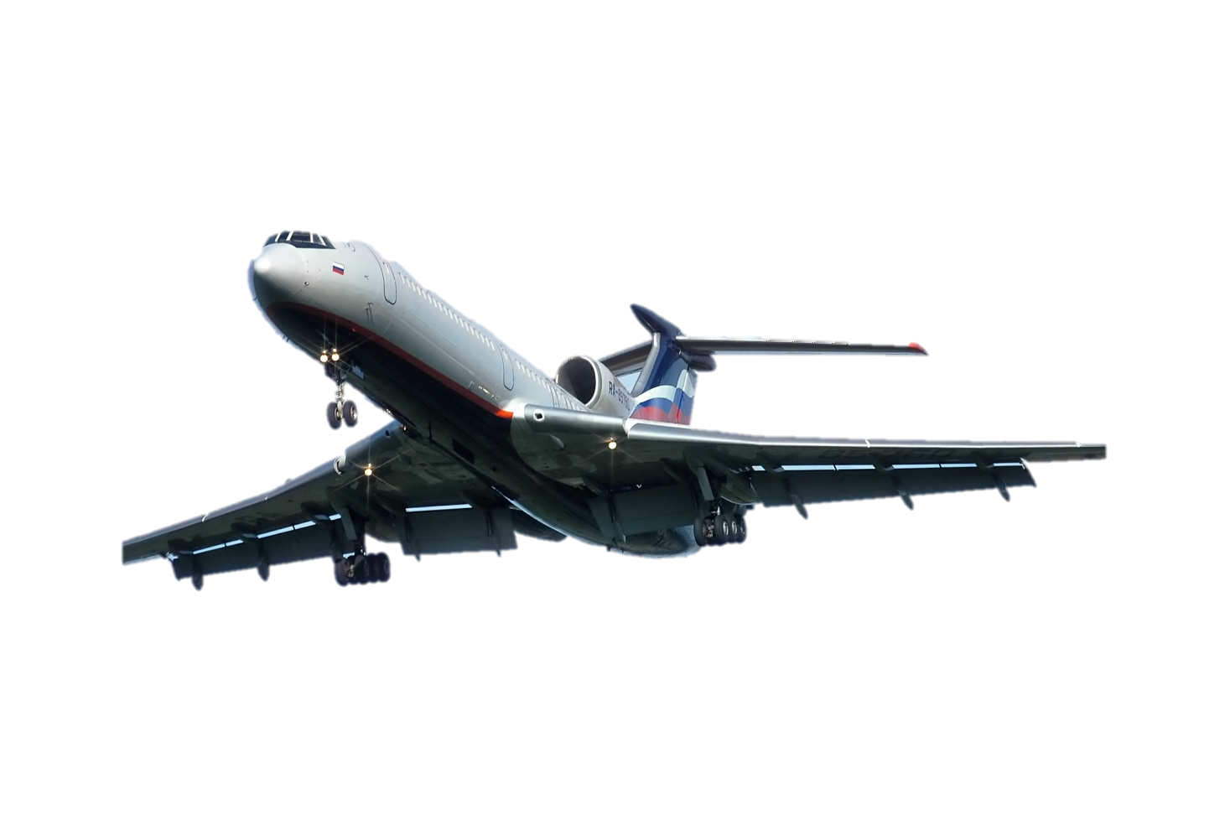
Locations
Why are we vaccinating in so many countries—when only 2 are endemic?
One international plane ride away!
Virus can be carried by anyone
Vaccination ongoing in 35-50 countries
Because of carriers, can’t stop vaccinating in other countries until all wild cases gone everywhere

Slide 15
More Cases
What caused the increase in wild polio cases in 2019?
Worldwide: 176 wild virus cases in 2019 (33 total in 2018). Type 3 virus now eradicated
Africa: 3+ years with 0 wild virus cases Just certified the Continent of Africa as Polio free.
Pakistan: 147 in 2019 (12 in 2018). Workers killed; false propaganda
Afghanistan: 29 in 2019 (21 in 2018). Taliban
Lack of access to vaccinate is culprit!
(U.S. has been polio free since 1979)

Slide 16
Covid-19
How is Covid-19 affecting the fight against polio?
Polio eradication infrastructure is also being applied to fight Covid-19 over a substantial period of months
Tools, workforce, surveillance network, lab testing, data management, Emergency Operation Centers (EOCs), vehicles, computers, mobile phones being deployed in support of Covid-19 fight
Temporarily, house-to-house polio vaccinations were paused; Pakistan resumed on 20 July

Slide 17
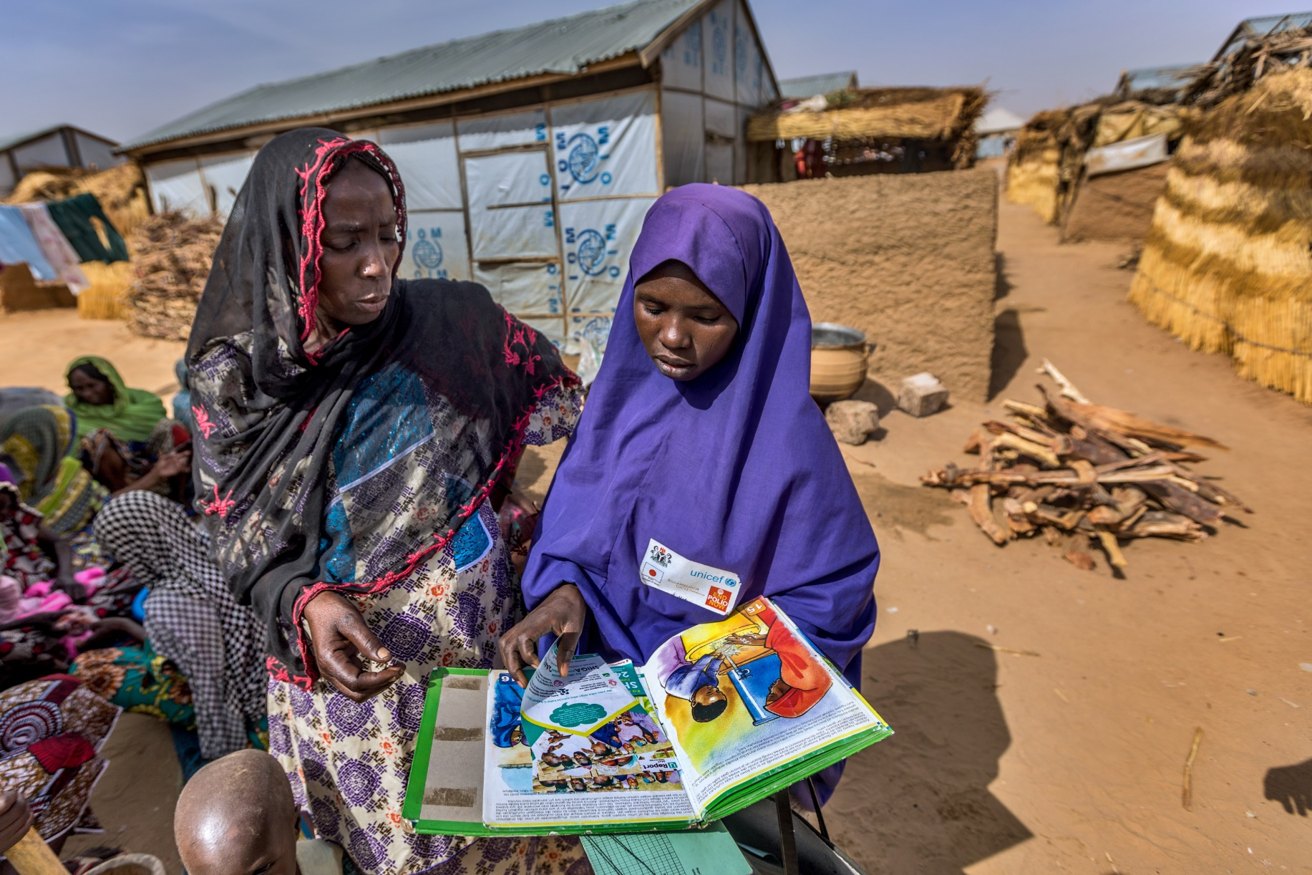
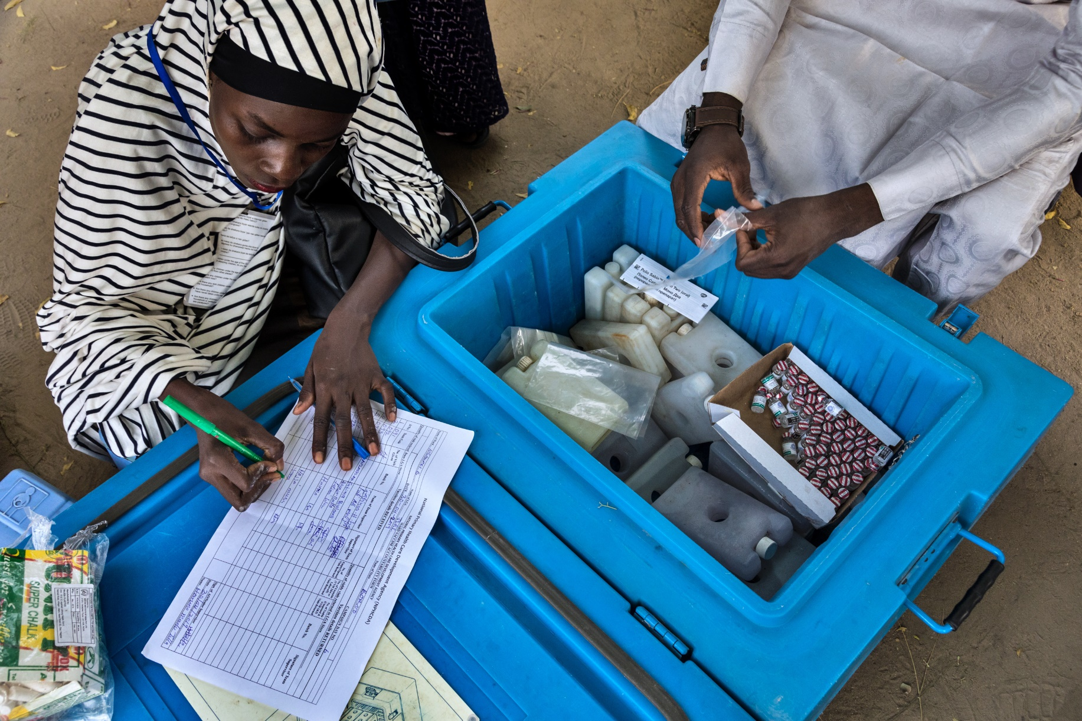
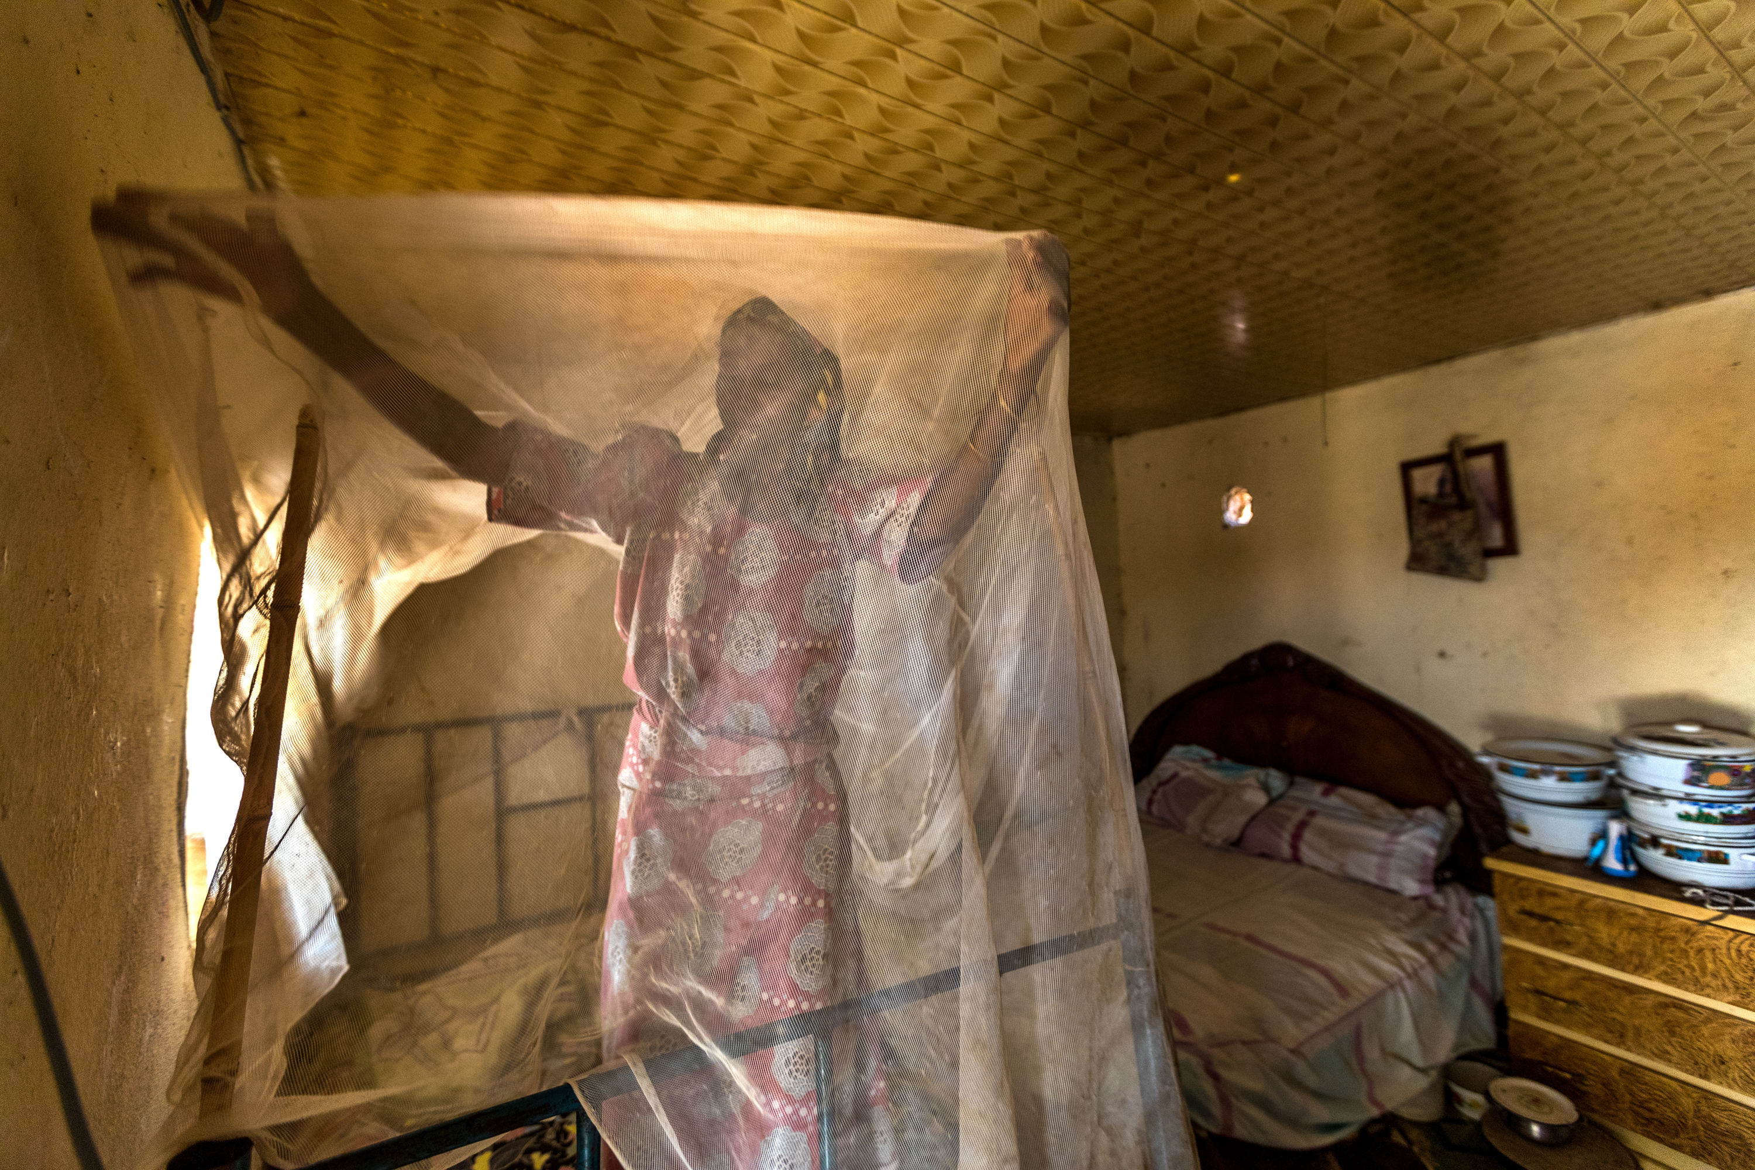
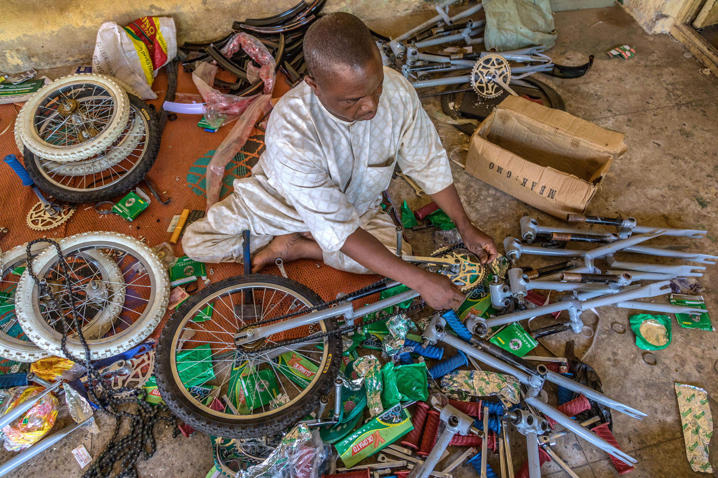
WHAT IS THE “PLUS”
Educate the population, in addition to the Polio vaccine, COVID-19, add other vaccines for diseases unique to the region, support local Rotarians & health professionals deliver health services to every child
Notes:
(L) Rotarians’ contributions to PolioPlus help fund planning by technical experts, large-scale communication efforts to make people aware of the benefits of vaccinations, and support for volunteers who go door to door.
(R) Polio vaccination campaigns are difficult to carry out where insurgency has displaced millions of people, leading to malnutrition and spikes in disease. When security allows, health workers diligently work to bring the polio vaccine and other health services to every child, including going tent to tent in camps for displaced people.

Slide 18
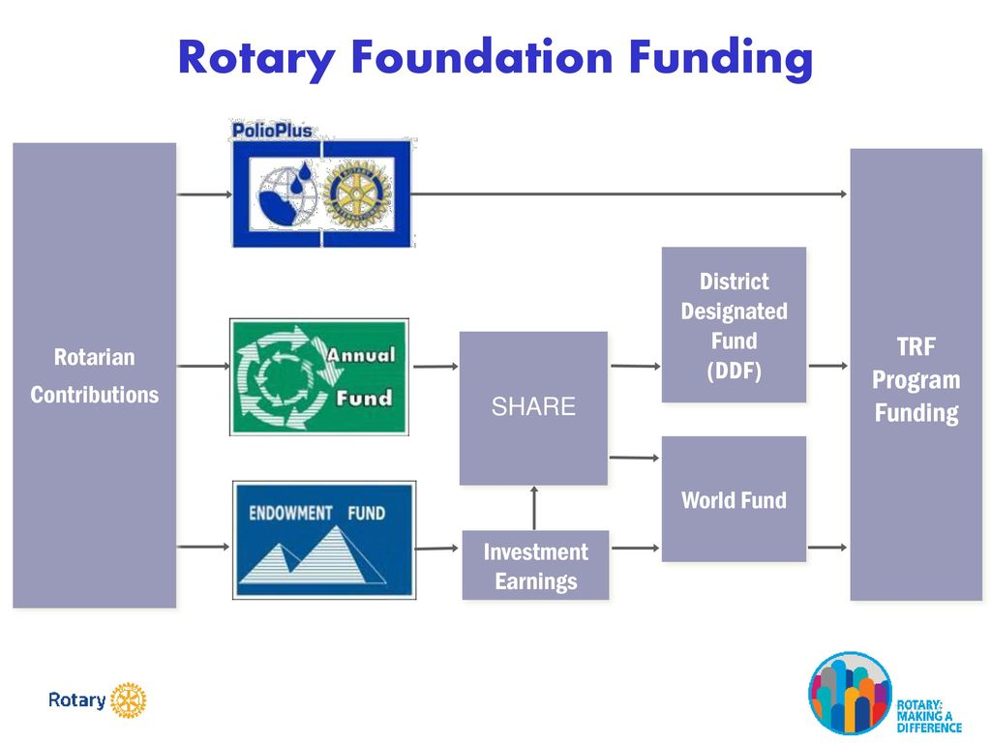
How do you leverage your Legacy
Gift to PolioPlus - Forever
Our investment
+ Gates 2:1
Direct Gift in cash
PHF, PHS,
Named Endowment or
Bequest >$25,000

Slide 19
DDF Pledges to Polio Plus
What does “Changes” Mean
  As of 1 July 2021
    World Fund match – 50% (was 100%)
    Gates Match unchanged
  Example:
    DDF transfer of $20,000, WF match is $10,000 = $30,000
    Gates matches 2:1 = $60,000
    Grand Total = $90,000 to PolioPlus.
Notes:
Why was this option changed? Two years ago, we changed the WF match from 50% to 100% in hopes of attracting more DDF transfers, especially knowing almost $50M in DDF on average has been rolling over for years. Unfortunately. this did not result in the transfers we anticipated.
This decision along may provide up to an additional $5M in WF money to support GG beginning 2021-22.
Remember, the Gates 2 to 1 match will not change. That generous foundation will continue to match every dollar Rotary commits to for polio eradication up to $50 million each year resulting in up to $100M each year.
Please also remember that we continue raising the $50M to take full advantage of the Bill and Melinda Gates match. Please continue to keep this a top priority in your club, communities and with government officials.

Slide 20
Support PolioPlus through the Annual fund is the engine that drives our district giving
TRF Holds for
3 yrs.
25%
Community
Your investment of $2 just turned into $6
100%
100%
50%
50%
50%
District Pledge - $20,000
World Fund Match - $10,000
Gates matches 100%
50% Match
25%
DDF Global

Slide 21
District 7620
Past and Next
Gates 2:1
$60k

Slide 22
Club Planning
2020-21 PolioPlus Goals
Every club member has PolioPlus goal of at least $45 per member per Rotary calendar year (or club average per cap of $45 per year)
Every club considers a public awareness fund-raising project in its community to assist in achieving their PolioPlus goal
PolioPlus contributions may be made on TRF Donor Forms
Notes:
KEN Weiss

Slide 23

Donate on Line
  https://www.endpolio.org/donate?gclid=EAIaIQobChMIg-PJ_uSG7AIVFYTICh3YFgy8EAAYASAEEgJa9PD_BwE

Slide 25

Make This a Project in Your Club
www.wgmeal.com

Slide 26
Who is our Rotary International Coordinator?
Michael K. McGovern, chair of Rotary's International PolioPlus Committee
June 10, 2019 --- “We have the wild poliovirus cornered
in the smallest geographic area in history.”

Slide 27
Who are our partners with it’s goal to eradicate polio world-wide?
As a founding partner of the Global Polio Eradication Initiative, Rotary has led a global initiative focused on ridding the world of the disease for 30 years now, which has already resulted in the reduction of polio cases by 99.9% since its first project to vaccinate children in the Philippines in 1979.
The Global Polio Eradication Initiative is a public-private partnership led by national governments with six partners – Rotary International, the World Health Organization (WHO), the US Centers for Disease Control and Prevention (CDC), the United Nations Children’s Fund (UNICEF), Bill & Melinda Gates Foundation and Gavi, the vaccine alliance.
Notes:
-

Slide 28
What are the costs ?
Rotary members have contributed more than $2.1 billion and countless volunteer hours to protect nearly 3 billion children in 122 countries from this paralyzing disease.
Rotary's advocacy efforts have played a role in decisions by governments to contribute more than $10 billion to the effort.
The cost of polio eradication has now reached US$ 4.5 billion, compared with the initial estimate of US$ 2 billion.
The program needs an additional US$ 575 million for the coming two to three years.

Slide 29
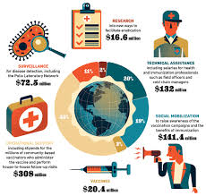
How is our money used

Slide 30
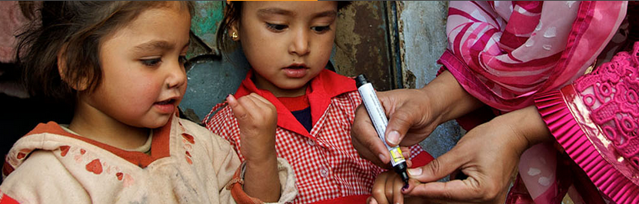
How many Lives Saved ?
When the Global Polio Eradication Initiative was formed, polio paralyzed more than
350,000 people a year.
Since that time, polio case numbers have decreased by more than 99%.
More than 16 million people have been saved from paralysis because of vaccination efforts against polio.
Michael K. McGovern, Chair of Rotary's International PolioPlus Committee “We have the wild poliovirus cornered in the smallest geographic area in history”

Slide 31
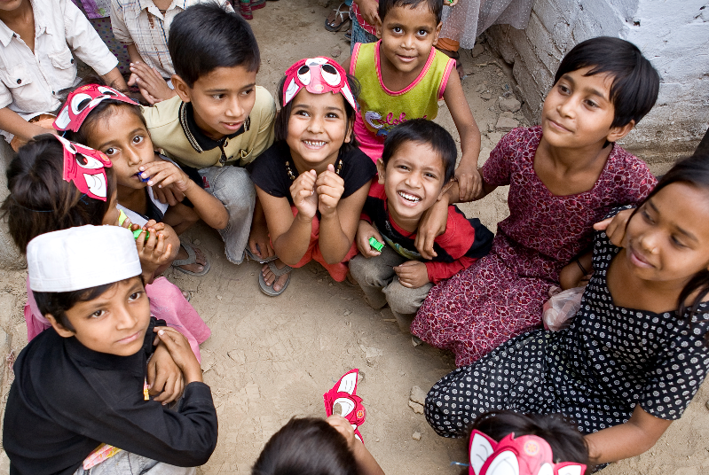
Thank you, Rotarians, !

Slide 32
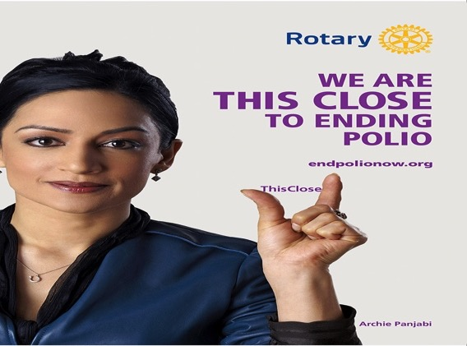
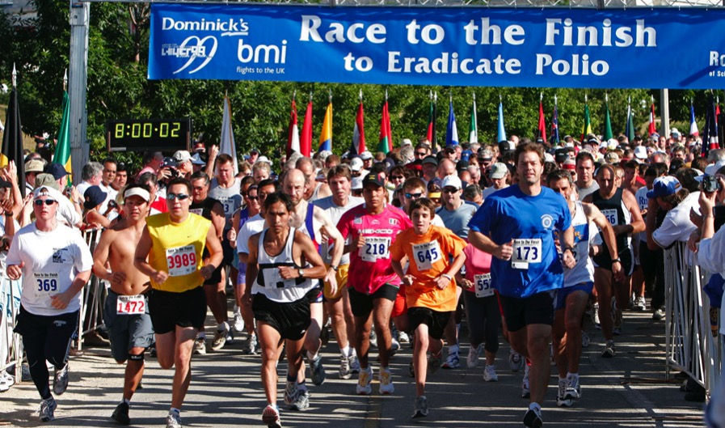
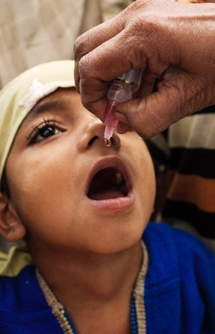
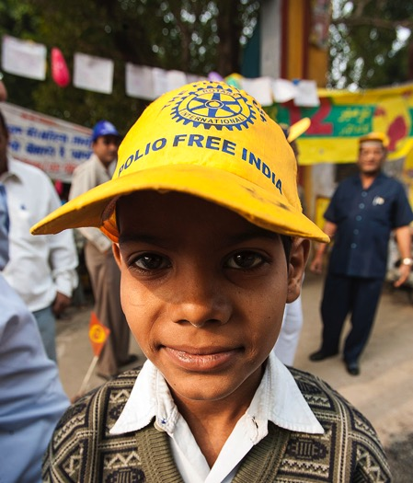
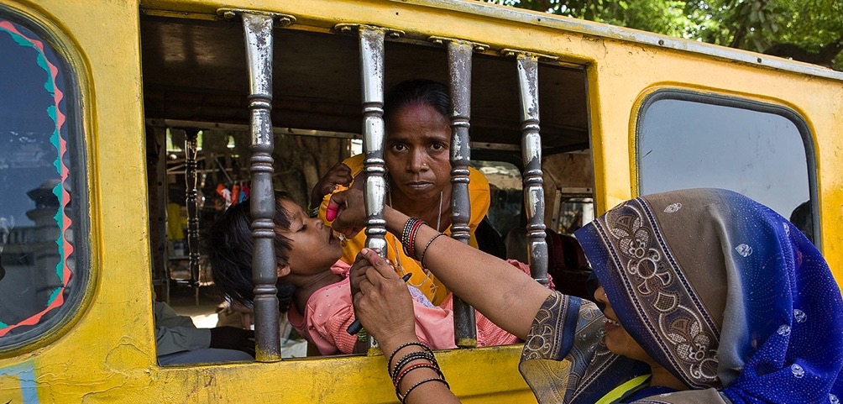
PolioPlus
104 YEARS OF DOING GOOD IN THE WORLD

Slide 33


QUESTIONS
PDG Rich Glover, District Rotary Foundation Chair
Cell: (301) 980-4976
Email: 18.19.dg7620@glovercrew.net
Notes:
We have ___________ minutes remaining in the hour and I would enjoy any clarifications and questions may have.

Slide 34
How Did the Idea of Polio Eradication Become a Global RI/TRF Initiative
The Documentary https://daretodreamfilm.com/
How Rotary Became the Heart and Soul of Polio Eradication
February 24, 2018 Dare to Dream, District Conference, Foundation, Leadership Team Training, PDG Ken Solow
The new documentary trailer, Dare to Dream, How Rotary Became the Heart and Soul of Polio Eradication, is only 2 minutes and 55 seconds long. It is free and is easily streamed right from the Dare to Dream website at daretodreamfilm.com. The trailer introduces the movie with Dr. John Sever talking about why in 1979 he recommended to then RI President, Clem Renouf, that Rotary should choose polio if the organization was looking to eradicate a single disease. Rotary clubs, and Rotary districts, can easily make time in virtually any club program or District training to show the 3-minute trailer and recommend to clubs that they can watch the first 16 minutes of the film as a free club program. Hopefully from there Rotarians will make the leap to dropping $25 to buy the film and learn the rest of our story. The purchase includes making an $18.75 contribution to Polio Plus.
The trailer does a great job of promoting the film if for no other reason that the quality of the production is readily apparent. If you haven’t seen it, well….here it is.
The back story to the trailer is interesting. First, we didn’t have the money to shoot an actual movie trailer so we used the first few minutes of the movie. The film didn’t originally have this introduction. After showing the film to test viewers we consistently heard from them that the first half of the movie lacked context. The script faithfully follows the story as told by Sarah Gibbard Cook in her book, Rotary and the Gift of a Polio Free World. The first half of the movie introduced a lot of different characters and stories, including “Daddy Allen,” the story of small pox eradication, and the creation of the 75th Anniversary Fund. Both Rotarians and non-Rotarians were a little frustrated because they didn’t know why they were wading through these back stories. We decided to write an introduction that would “set up” the first half of the movie and help the audience place the entire drama in its proper time and place.
Not that anyone should compare me to George Lucas, but it was interesting to learn that early tests of the first Stars Wars movie revealed a similar problem with his audience. They simply had no context for the story and complained that it didn’t make any sense. Perhaps the fact that some of his buddies including guys like Steven Spielberg made a difference, but the result was the famous Star Wars opening crawl. Do you remember watching this for the first time in the theater? Was there ever a time we didn’t immediately recognize “A Long Time Ago, In a Galaxy Far Far Away…” It was followed by that iconic shot of the Imperial Star Destroyer soaring over our heads…our first introduction to George Lucas and CGI. (sigh) Here’s the crawl…
After I wrote a script for the introduction, Dare to Dream Director, Ilana Bittner, made another great choice in deciding that we wouldn’t use a narrator to read the script. Instead she decided to use some of the four hours of interviews we shot with Dr. John Sever interspersed with the text from the script. The result not only solved our problem of helping our audience settle back and enjoy learning the back story we were determined to tell, but also gave Dr. John the opening voice to the movie. Ilana and I were proud to give John both the first word and the last word in the movie, an honor we thought was well-earned.
So there you have it…”the rest of the story.” Please show this trailer to your Rotary club or at a District training. PETS trainings are being held all over the world at this time of year. Please consider taking five minutes to show the trailer to Dare to Dream and explain that clubs can enjoy the first 16 minutes of the movie (plus credits) as a FREE club program. And yes, if you care to you might ask Rotarians to buy the film and enjoy a wonderful story while making a donation to end polio forever.
Download the movie trailer, the free 18-minute movie trailer, or purchase the film at Dare to Dream, How Rotary Became the Heart and Soul of Polio Eradication.

